Slide 1
Problem Statement Worksheet (Hypothesis Formation)
How can Big Mountain Resort define their investment strategy and restructure their pricing policy to capitalize on its facilities and select a better value for their ticket price in order to increase profits by 10% by the end of the year?
1
Context
4
Constraints within solution space
Every year, about 350,000 people ski or snowboard at Big Mountain Resort in Montana. This resort accommodates skiers and riders of all levels and abilities and is serviced by 11 lifts, 2 T-bars, and 1 magic carpet for novice skiers. While the resort’s current pricing strategy has been to charge a premium above the average price of resort in the its market segment, Management is looking to update pricing based on a defined and effective investment strategy, taking into account the profitability of each resort facility as well as opportunities for cutting costs without undermining ticket prices.
Need to accommodate market demand while increasing profitability - If the result of the analysis is a big ticket price increase, that may affect customer’s demand for and purchase of tickets after the price increase goes into effect.
Unforeseen changes in weather patterns may impact the cost of operations and facilities offered
2
Criteria for success
5
Stakeholders to provide key insight
Success for this project = Identification of the following:
Profitability of each of Big Mountain Resort’s facilities
Validation over the proposed changes affect profitability and ticket price
An updated ticket price policy expected to bring in 10% increase in profits based on facility profitability and proposed changes affecting profitability
Director of Operations: Jimmy Blackburn
Database Manager: Alesha Eisen
3
Scope of solution space
6
Key data sources
Focus will be placed on the profitability of each Big Mount Resort facility as well as Management's list of proposed changes intended to affect profitability
Single csv file obtained from the Database Manager containing relevant information from 330 resorts in the US (including Big Mountain Resort) that are part of the same market share as Big Mountain Resort
Notes:
https://docs.google.com/presentation/d/1KwzlwiBm1oeyGMLsGO-vsv4eIO8MJgHxeVXfgM9UQcw/edit?usp=sharing

Slide 2
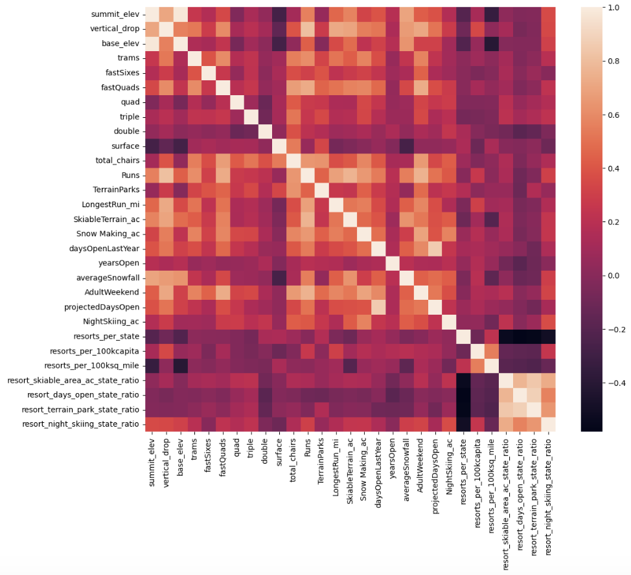
Recommendations and key findings
Feature correlation heatmap
Key Findings:
The resort level detail heatmap highlights the following relationships amongst the features:
The target feature, AdultWeekend (ticket price) had several reasonable correlations, including:
fastQuads, Runs,
total_chairs,
Snow Making_ac.
This leads us to believe that visitors seem to value more guaranteed snow and that more runs require more chairs to ferry people to them.
As the correlation with AdultWeekend and the total skiable terrain area was not as strong as ticket price with snow making, it appears people value guaranteed snow cover over more variable terrain area.

Slide 3
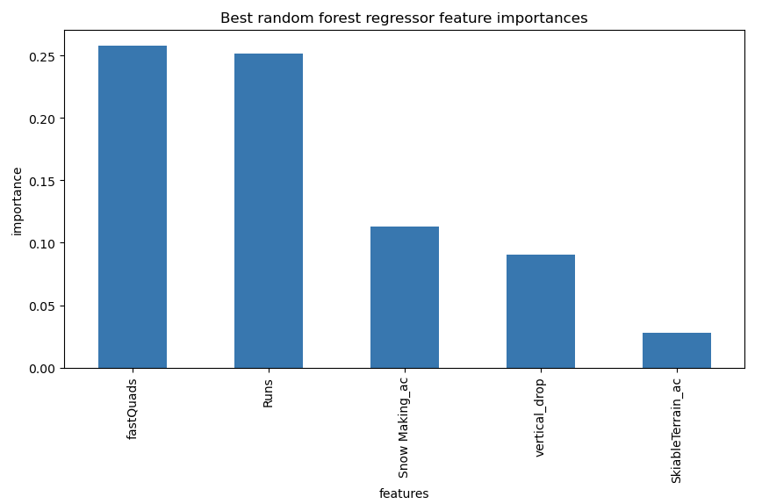
Modeling Results and Analysis
Random forest regressor model
The random forest model was selected as the final model because it had a lower cross-validation mean absolute error than the linear model tried by almost $1 and exhibited less variability. This validated the test set performance was consistent with the cross-validation results. Additionally, the dominant top four features agreed to those identified with the linear model (fast quads, runs, snow making, and vertical drop). As such, the random forest model was used going forward.
The random forest regressor model highlighted the following best features in regards to ticket price:
fast quads,
runs,
snow making,
vertical drop

Slide 4
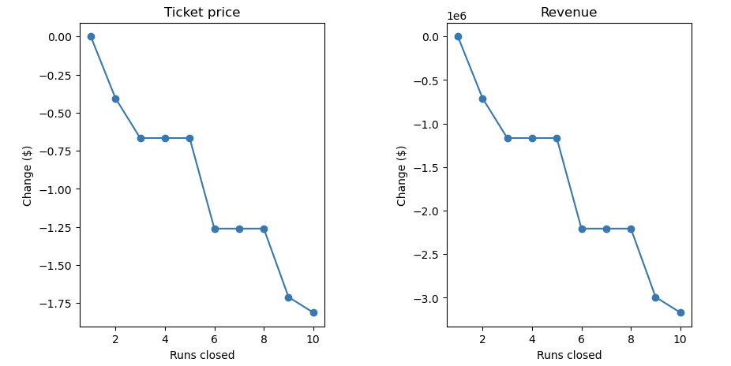
Modeling Results and Analysis
Random forest regressor scenario results
The random forest model was used for reviewing the following potential scenarios for either cutting costs or increasing revenue (from ticket prices):
Scenario 1: Permanently closing down up to 10 of the least used runs
The model says closing one run makes no difference. Closing 2 and 3 successively reduces support for ticket price and so revenue. If Big Mountain closes down 3 runs, it seems they may as well close down 4 or 5 as there's no further loss in ticket price. Increasing the closures down to 6 or more leads to a large drop.
Scenario 2: Big Mountain is adding a run, increasing the vertical drop by 150 feet, and installing an additional chair lift.
This scenario increases support for ticket price by $8.61. Over the season, this could be expected to amount to $15,065,471.
Scenario 3: Repeating the previous one but adding 2 acres of snow making.
This scenario increases support for ticket price by $9.90. Over the season, this could be expected to amount to $17,322,717.
Scenario 4: increasing the longest run by .2 miles and guaranteeing its snow coverage by adding 4 acres of snow making capability.
This resulted in no difference whatsoever.

Slide 5

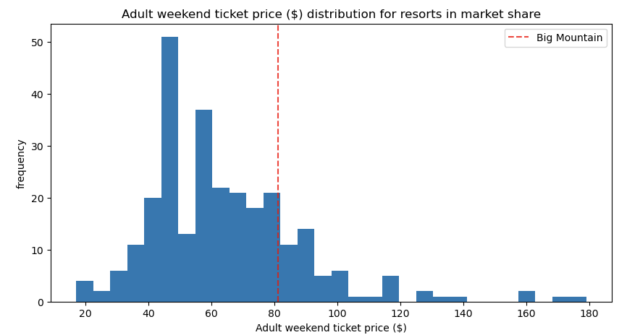
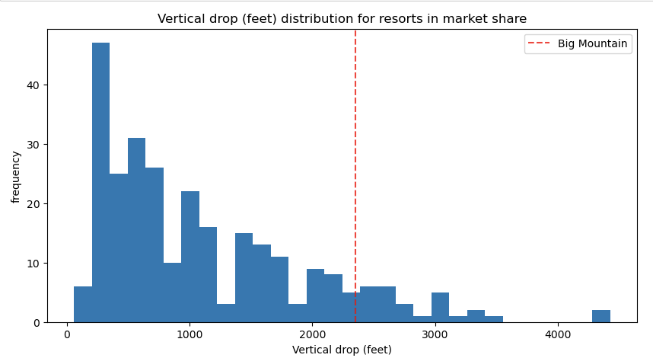
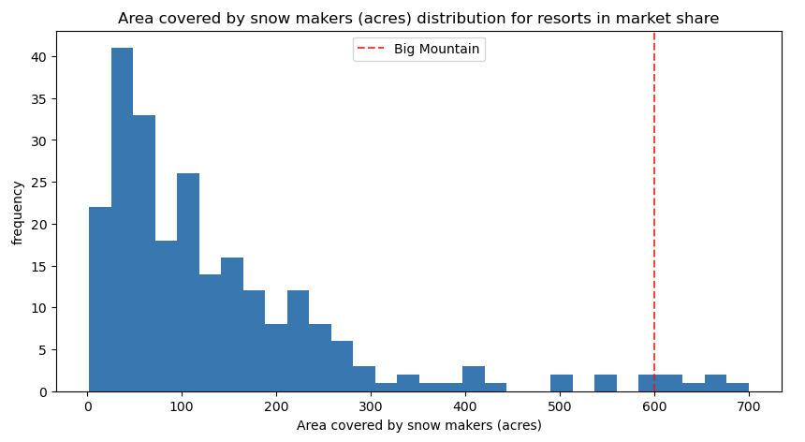
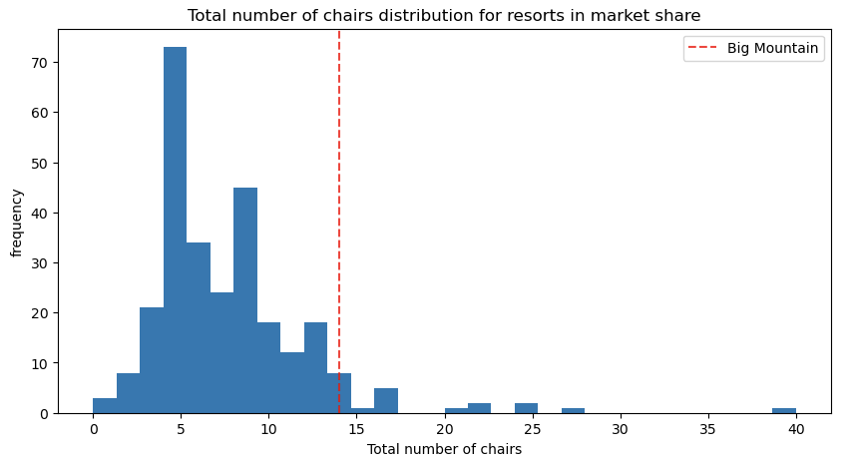
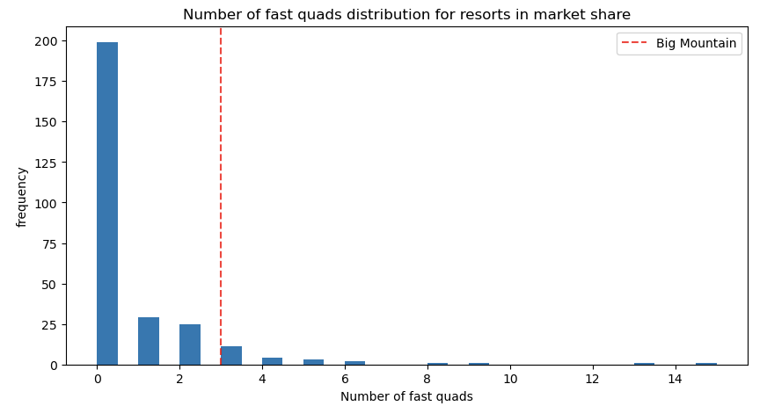
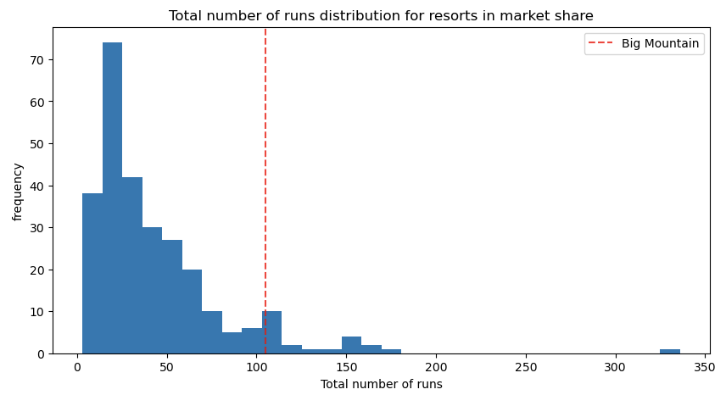
Modeling Results and Analysis
Big Mountain Resort in market context
Ticket Price
Vertical Drop
Snow Making Area
Total # of Chairs
Fast Quads
Runs

Slide 6
Summary and conslusion
Problem Statement: How can Big Mountain Resort define their investment strategy and restructure their pricing policy to capitalize on its facilities and select a better value for their ticket price in order to increase profits by 10% by the end of the year?
Big Mountain currently charges an average of $81 per ticket. However, the modelling suggests that Big Mountain's facilities support a ticket price increase to $95.87 (increase of $14.87).
The additional operating cost of the new chair lift per ticket (based on the average visitor purchasing 5 day tickets) supported a ticket price increase of $0.29 per ticket (total expected revenue of $507,246) if no other features were altered but this does not take in to account the operating cost of the additional chair lift. As the operating cost of the season for the additional chair lift is $1,540,000, the expected revenue from the additional chair lift does not cover this.
In order to calculate profit, the costs associated with the feature changes would need to be validated. Obtaining and analyzing the operating costs and costs associated with making the facility updates noted above would be helpful to truly understand how these updates would affect revenue if ticket prices were to increase based on them.

